Slide 1

Week 4 Practical: DES
CT5046 Cryptography and Security
University of Gloucestershire

Slide 2
Overview
DES visualisation
DES in CryptTool2
SDES
3DES
DES in python
Recap
PSS

Slide 3
Recap
Last week we looked at ADFGVX cipher and Vernam cipher
We also looked at how each of them works and how they can be implemented in CryptTool 2
This week we will be looking at DES

Slide 4
DES

Slide 5
DES visualisation
From the CryptTool 2 startup menu, click Cryptography
Then click Modern and then select Symmetric
Next click DES Visualisation
In the Plaintext box, type in: 50 52 45 43 49 4f 55 53 (hex for PRECIOUS)
In the Key box, type in: 4b 41 4d 49 4b 41 5a 45 (hex for: KAMIKAZE )
Finally click on the Play button to execute

Slide 6
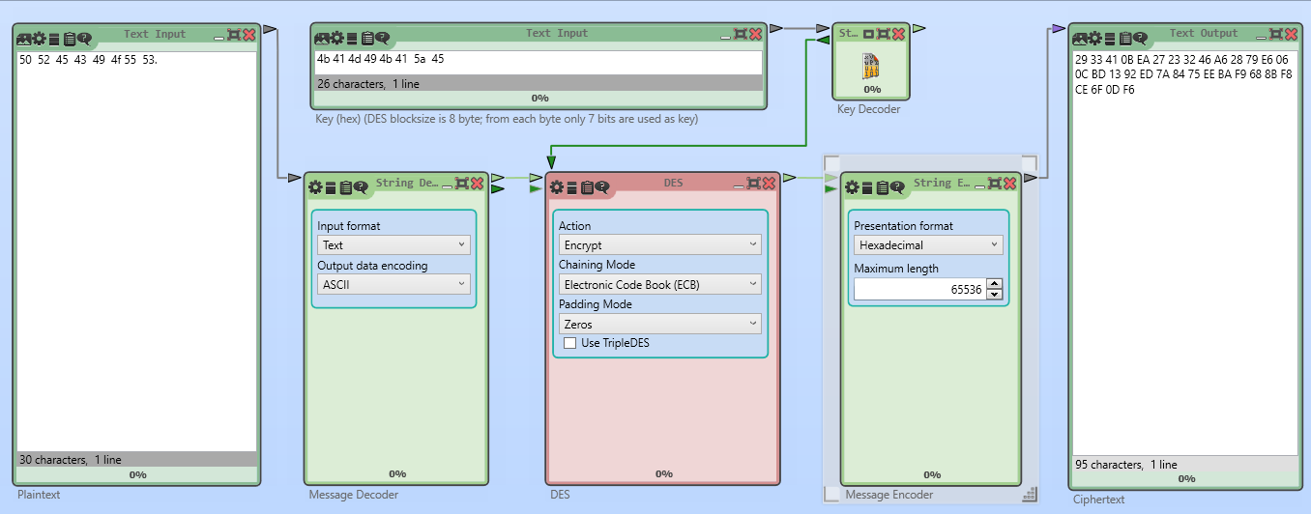
DES visualisation

Slide 7
DES in CryptTool2
From the CryptTool 2 startup menu, click Cryptography
Then click Modern and then select Symmetric
Next click DES Cipher
In the Plaintext box, type in: ROSES ARE RED
In the Key box, type in: 4b 41 4d 49 4b 41 5a 45 (hex for: KAMIKAZE )
Finally click on the Play button to execute

Slide 8
Simplified DES
Uses the same steps/components as regular DES Key differences lie in terms of:
Block size: Blocks of 12 bits instead of 64 bits Key size:
Only 9 bits instead of 56 bits
Intended to be used for experimental purposes

Slide 9
SDES in CryptTool2
From the CryptTool 2 startup menu, click Cryptography
Then click Modern and then select Symmetric
Next click SDES
In the Plaintext box, type in: ROSES ARE RED
In the Key box, type in: 0101000001
Finally click on the Play button to execute

Slide 10
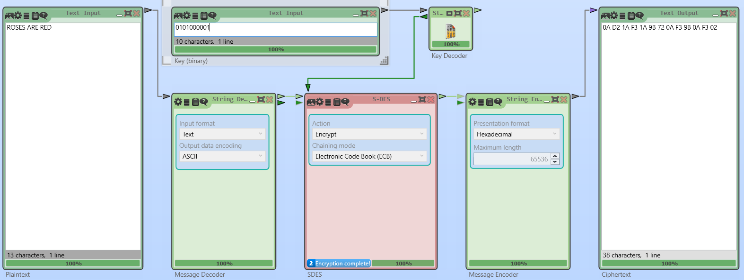
SDES in CryptTool2

Slide 11
3DES on CryptTool2
From the CryptTool2 startup menu, click Cryptography
Then click Modern and then select Symmetric
Next click Triple DES
In the Plaintext box, type in: ROSES ARE RED
In the Key box, type in: 010100000101010101011010010110100100110001000101 (binary for: PUZZLE )
Finally click on the Play button to execute

Slide 12
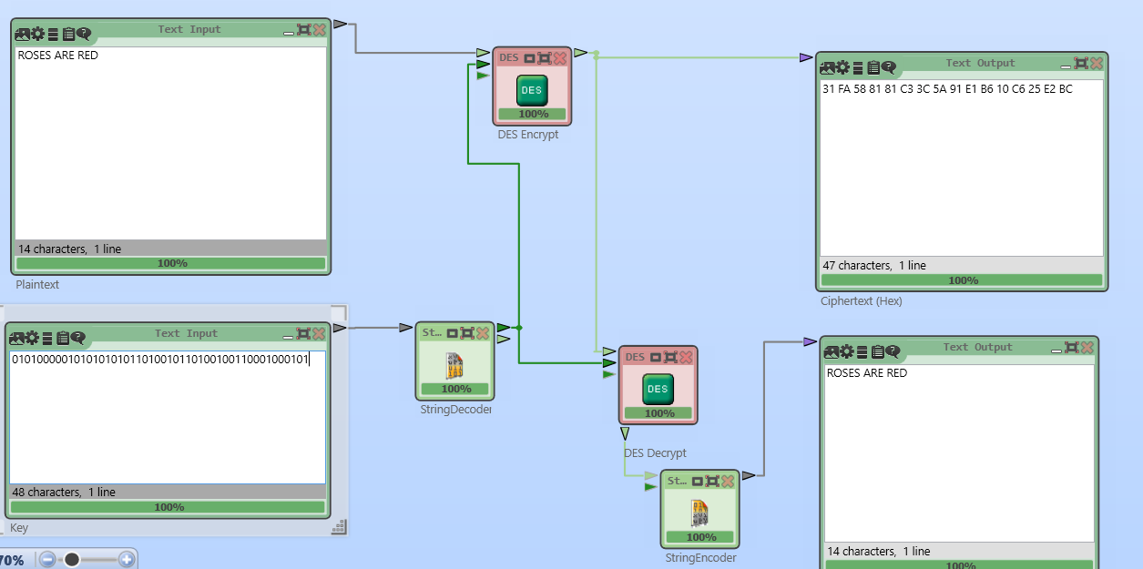
3DES in CryptTool2

Slide 13
Exercise
From scratch, create a project in CryptTool2 that:
Takes plaintext and encrypts it with a classical cipher we have looked at (use as many as you please)
Then encrypt with DES
Decrypt back to plaintext
Extra:
Change the format of what encrypts first to see if any changes occur
Instead of text, what about a file?
Add AES to the equation

Slide 14
Python and Cryptography

Slide 15
Overview
Python in Cryptography can be simple with only a few libraries
One of the main ones is pycryptodome
Can be installed in the libraires section of PyCharm but also via Cli:
Pip install pycryptodome

Slide 16
DES in python
from Cryptodome.Cipher import DES
from Cryptodome import Random
strKey = b'helloall'
obj_des = DES.new(strKey, DES.MODE_ECB)
strPlainText = b'Roses are red. Violets are blue!'
strCipherText = obj_des.encrypt(strPlainText)
print("Ciphertext: ", strCipherText)
strDecrypt = obj_des.decrypt(strCipherText)
print("Plaintext: ", strDecrypt)

Slide 17
Exercise
Change the code through:
Making so a file can be handled
Encrypting the file and decrypting it along with printing the results
Export the generated key from DES to a text file
Time how long each process takes
Challenge: Change the code to perform 3DES

Slide 18
Recap
We looked at Data Encryption Standard
We also looked at the different variations of DES in CryptTool2 and how it can be applied in python
Next week: Symmetric Encryption: AES, TwoFish and BlowFish

Slide 19
Q&A

